Slide 1
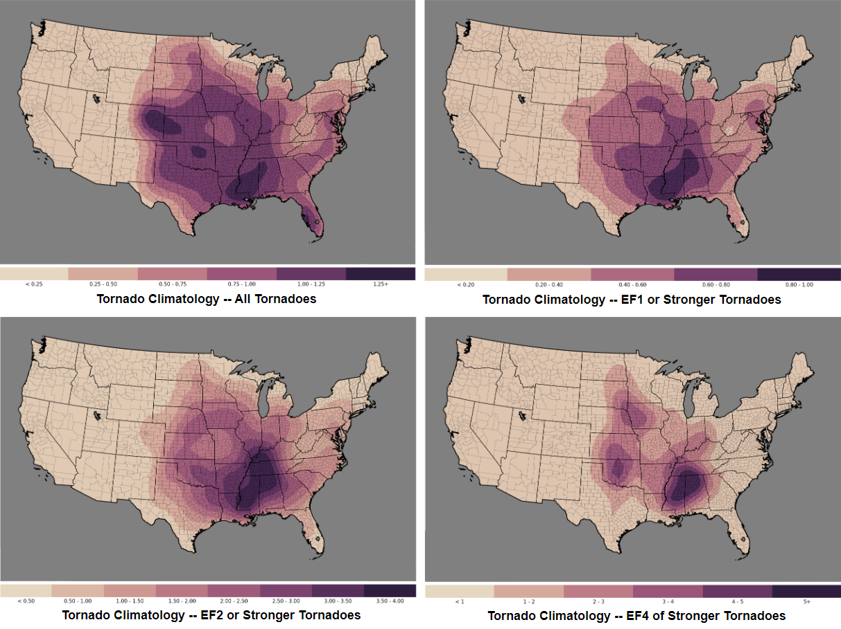
From F-scale to EF-scale: An Assessment on the Tornadoes Classification Laura Zhang
* This project involves the Severe Weather Database Files (1950-2019) of the U.S. National Oceanic and Atmospheric Administration (NOAA)
Notes:
I am going to talk about the change of standard for rating tornado intensity in the U.S. and how this change influenced the classification of tornadoes.

Slide 2
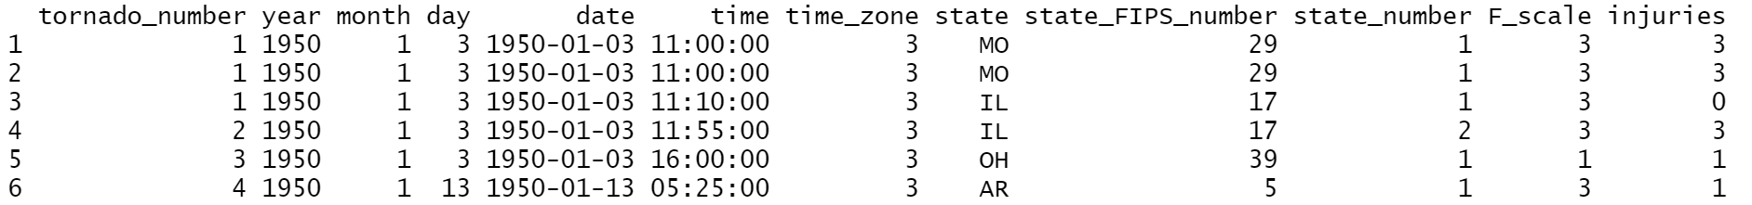
Notes:
These are the first columns of the dataset where F-scale was implemented nationally for rating tornado intensity.

Slide 3
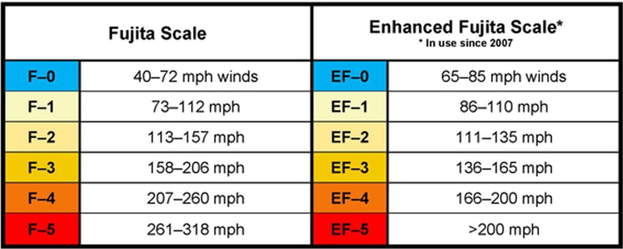
F-scale --> EF-scale
https://www.wtoc.com/2020/05/14/first-alert-weather-academy-how-tornadoes-are-rated
Notes:
According to the Database Description, unknown F-scale was recorded as -9 and, more importantly, since January 1, 2007, the F-scale was replaced by Enhanced F-Scale or EF-scale.
EF-scale also has six strength categories from EF0 to EF5, representing increasing degrees of damage. But the wind speed levels assigned to damage differs between the two scales.

Slide 4
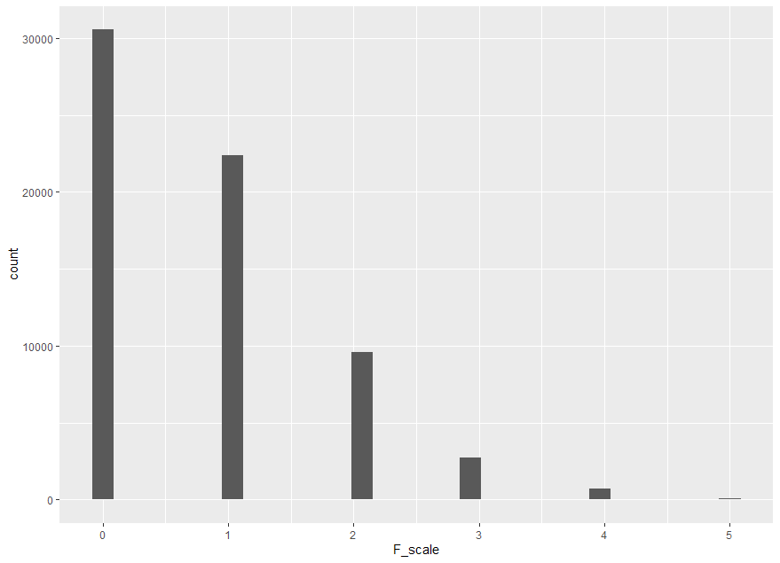
F-scale --> EF-scale
https://www.wtoc.com/2020/05/14/first-alert-weather-academy-how-tornadoes-are-rated
Notes:
I removed those rows with unknown F-scale and plot the tornado numbers of each scale, but this doesn’t make sense now, because the standard itself has changed in 2007.
So, did the change from F-scale to EF-scale bring any effects?

Slide 5
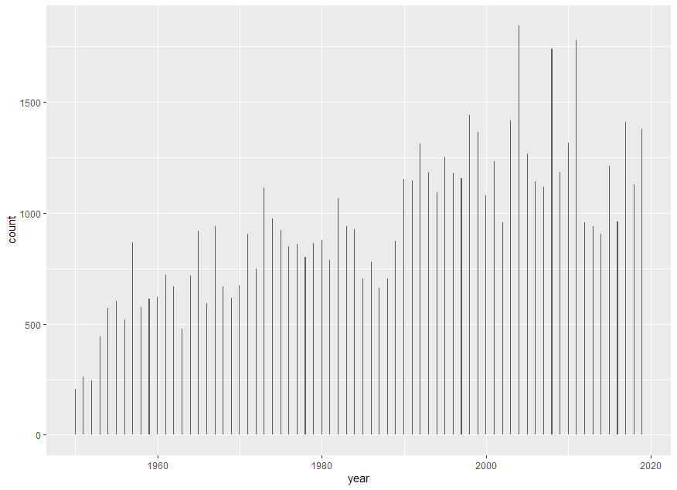
Overall tornado numbers have not changed dramatically
Notes:
Let’s see the overall tornado numbers from 1950 to 2019.
Generally, total cases after 2007 were not less than years before 2007. In fact, the number of cases actually increased according to the plot.

Slide 6
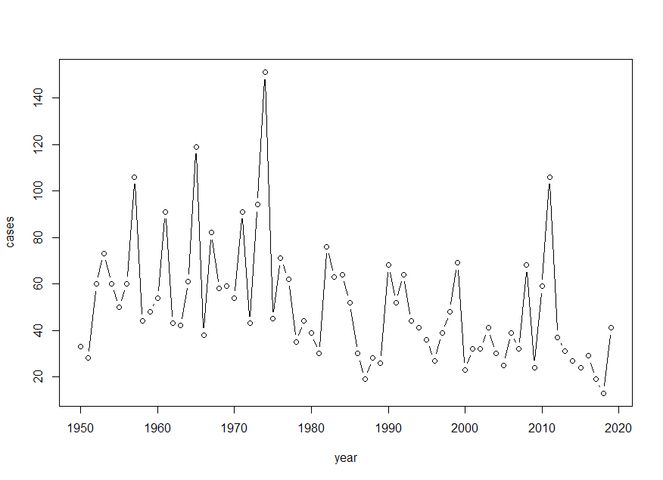
Overall tornado numbers have not changed dramatically
F3 (or EF3) scale tornadoes decreased since 2007
Notes:
But, it seems that there was a decrease in the number of tornadoes classified as EF3 and higher since 2007 and the reason should not be any decrease of total tornado cases.

Slide 7
Did the EF-scale lead to a decrease in the number of tornadoes classified as EF3 and higher?
Notes:
So, was it the EF-scale that leads to a decrease in the number of EF3 and even severer tornadoes?

Slide 8
Did the EF-scale lead to a decrease in the number of tornadoes classified as EF3 and higher?
Null hypothesis:
No
Alternative hypothesis: Yes
Notes:
Here are my hypothesis. I think yes but we need to do a test as a strong evidence.

Slide 9
1950-2006
Mean
2007-2019
Null
Significance level | 0.05
Mean | 48.45
Null | 33.66
n | 13
Standard Deviation | 24.21
Standard Error | 6.71
T-score | 2.20
P-value | 0.04800562
Notes:
We set significance level as 0.05.
Mean is calculated from the tornadoes whose scales are above F3 from 1950 to 2006.
Null is the mean value of the tornado numbers whose scales are above EF3 from 2007 to 2019, which include 13 years so n is 13.
And we got the p-value, 0.048

Slide 10
Did the EF-scale lead to a decrease in the number of tornadoes classified as EF3 and higher?
Notes:
Back to the question, Did the EF-scale lead to a decrease in the number of tornadoes classified as EF3 and higher?
I would say,

Slide 11
Did the EF-scale lead to a decrease in the number of tornadoes classified as EF3 and higher?
Alternative hypothesis: Yes
Notes:
That we have evidence that the shift from F-scale towards EF-scale did lead to a decrease in the number of tornadoes classified as EF3 and higher.
In fact, EF-scale considers not only wind speed but more on construction quality and standards of various structures. So a tornado with a rating of F5 on the F-scale may be classified as EF4 or even lower following the EF-scale.

Slide 12
In the future,
we will focus on whether
the EF-scale has brought changes to the
public safety
and
tornado assessment.
References
https://www.cdc.gov/disasters/covid-19/docs/318076A_Hurricane-key-Messages-COVID-19_HTML.pdf
https://en.wikipedia.org/wiki/Fujita_scale
McDonald, J. R. (2001). T. Theodore Fujita: His contribution to tornado knowledge through damage documentation and the Fujita scale. Bulletin of the American Meteorological Society, 82(1), 63-72.
https://en.wikipedia.org/wiki/Enhanced_Fujita_scale
Doswell III, C. A., Brooks, H. E., & Dotzek, N. (2009). On the implementation of the enhanced Fujita scale in the USA. Atmospheric Research, 93(1-3), 554-563.
Notes:
There are limitations in this test, such as the value of n is too small (in fact, it has been only 14 years since EF-scale was implemented in the U.S.), and many of cases occurred before 1970 did not have available F-scale record, which might have caused errors in the test.
In the future, we will focus on whether the EF scale has brought changes to the public safety and tornado assessment.

